Slide 1
Battle of the neighbourhoods
New York vs toronto

Slide 2
Problem statement
Understand the similarity and differences of neighbourhood between Toronto & New York.
Select the best possible neighbourhood for a corporation to move its headquarters based on locality.

Slide 3
Objective
Collect top venues for respective locality using Foursquare.
Use unsupervised k-means clustering algorithm to form clusters based on venue category.
Identify similarity and differences between neighbourhoods of Toronto and New York.

Slide 4
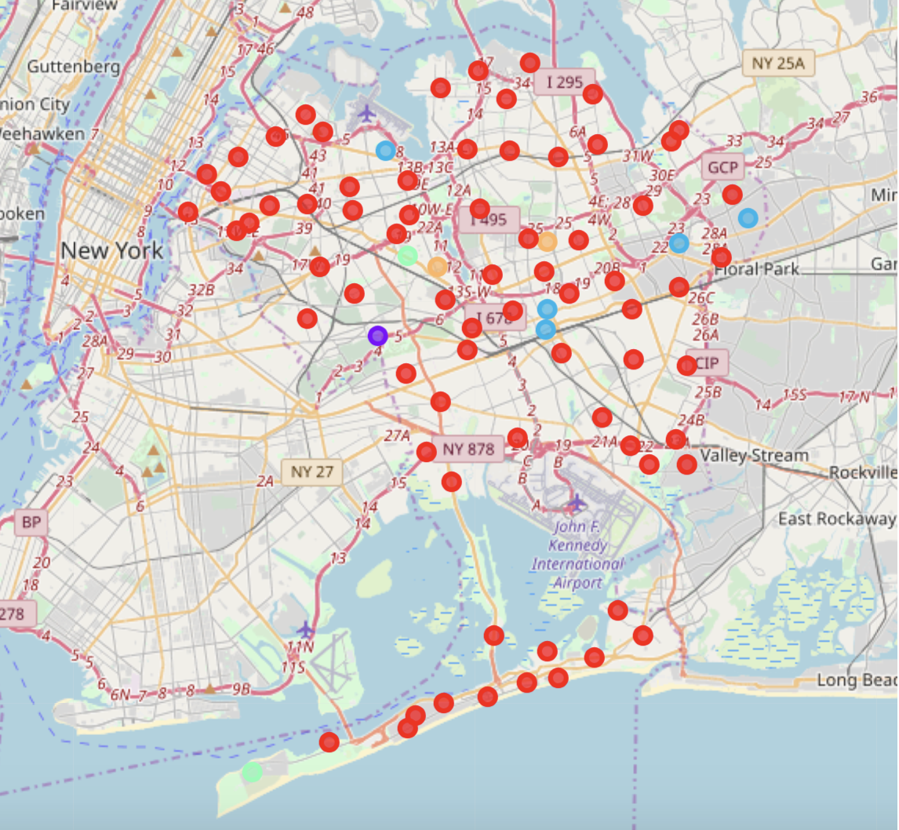
New York
Text
Neighbourhood cluster in New York.

Slide 5
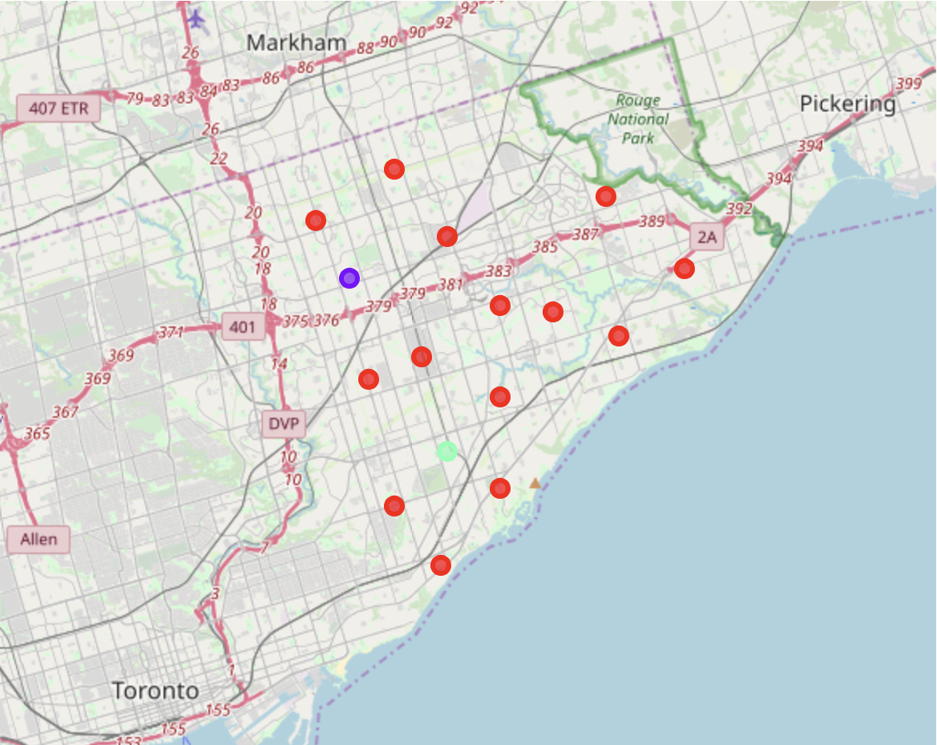
Toronto
Text
Neighbourhood clusters in Toronto.

Slide 6
Comparison between Scarborough(Toronto) vs queens(New york)
Scarborough has 79 distinct venues in 52 categories.
Common venues include coffee shop, international restaurants and skating ring.
Queens has 1760 distinct venue in 269 categories.
Common venues include coffee shop, parks, bakeries and bodegas.

Slide 7
Conclusion
Based on the quantity of venues and variety of venues, Queen is a better choice than Scarborough to relocate the headquarters of the corporation. Queen offers a greater amount of the gym, grocery store, restaurants for individual and families of employees.

